Slide 1
Ariba Sourcing User Manual
Responding Auction (Supplier)

Slide 2
Objective
The goals of this user manual are to:
Understand the process of accessing Auction Event
Understand the process of responding to Auction Event
Target Audience:
Procurement Manager
Senior Procurement Manager
VP
CEO
Course Pre-requisites:
Sourcing Reverse Auction 01_ES_Sourcing_Reverse Auction (Buyer)_2019_04_01

Slide 3
Process Flow
Login to Supplier Portal
Access Auction Event
Review and Accept Bidder Agreement
Select Lots
Enter and Submit Responses
Enter Required Details
3

Slide 4
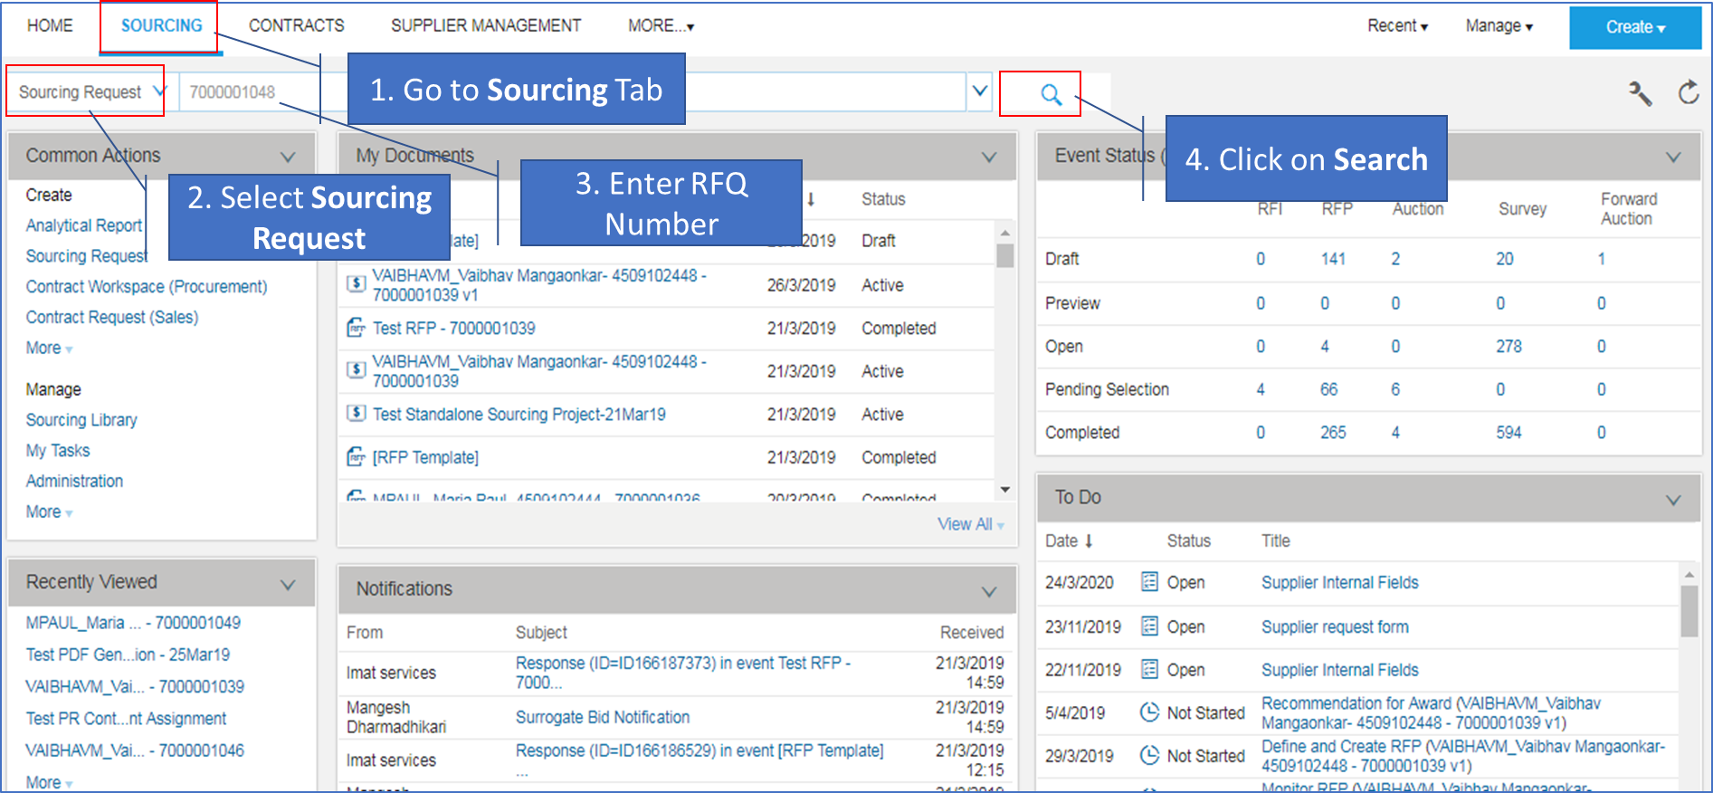
Notations Used in Training Manual
Number denotes the sequence of the steps to be followed.
The text talks about specific action to be taken.

Slide 5
Login To Ariba Supplier Portal

Slide 6
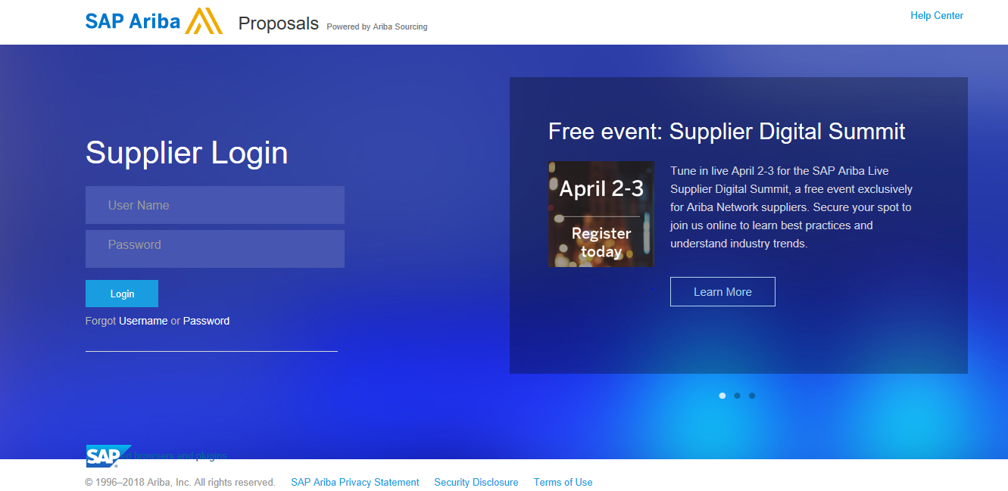
Supplier Log-In Page
1. Enter User Name
2. Enter Password
3. Click on Login Button

Slide 7
Accessing Auction Event

Slide 8
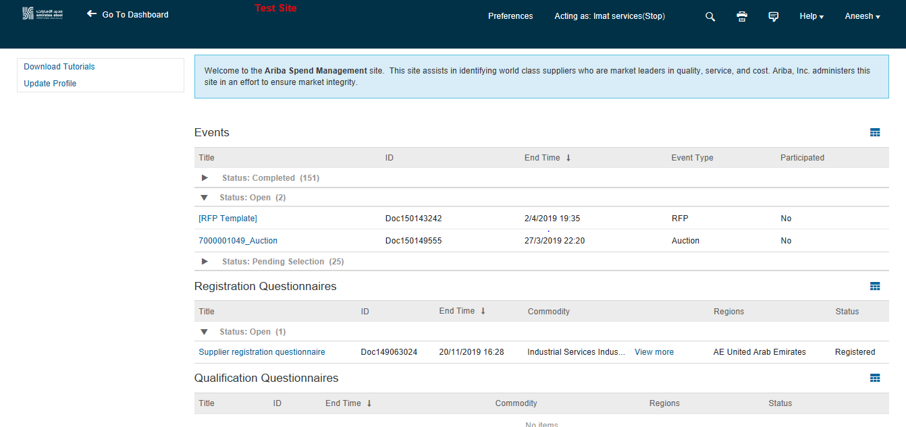
Supplier Dashboard
1. Click on Auction Event

Slide 9
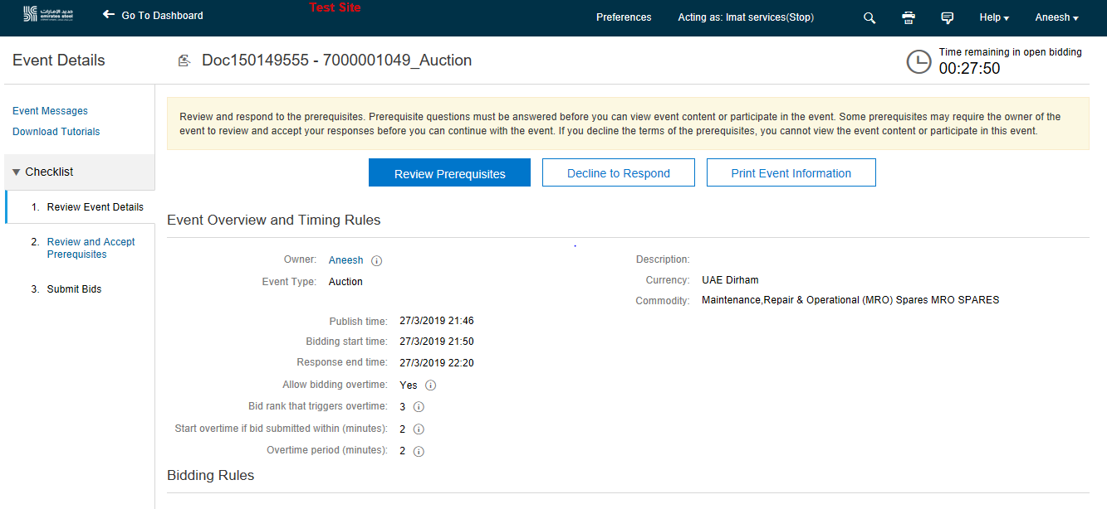
Reviewing Prerequisites
1. Click on Review Prerequisites

Slide 10
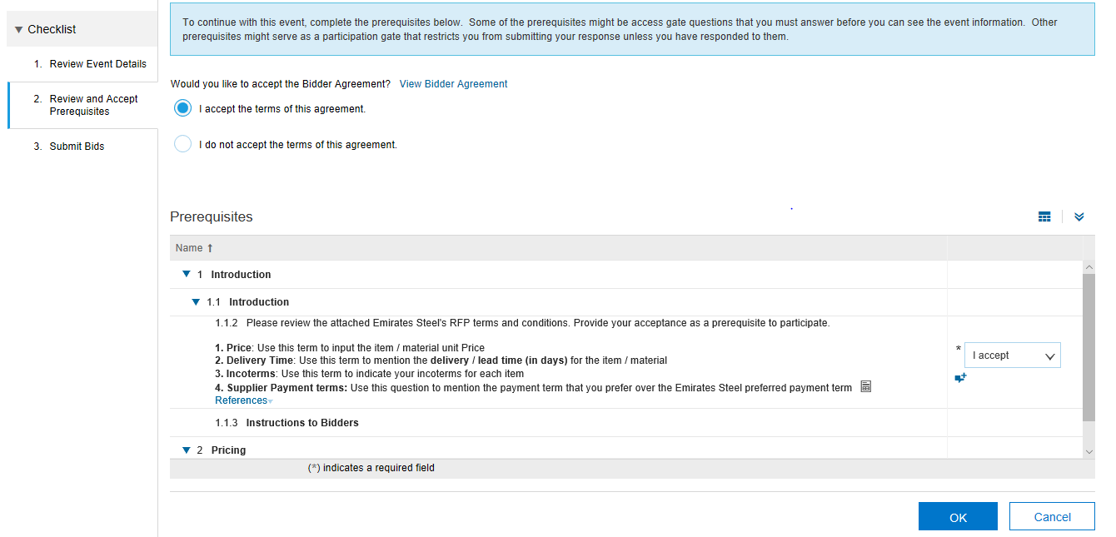
Reviewing Prerequisites – Accept/Reject
1. Click on View Bidder Agreement
Supplier Accepting Bidder Agreement & T&C of Emirates Steel. In Comment Box Supplier can give his comment if he is not agreeing to any of ES T&C
2. Click on
OK

Slide 11
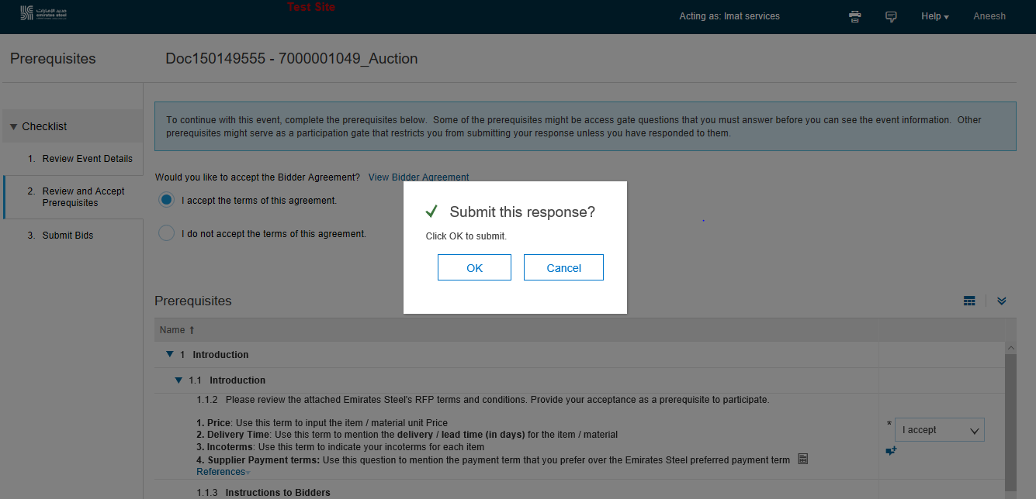
Reviewing Prerequisites – Accept/Reject
1. Click on Ok

Slide 12
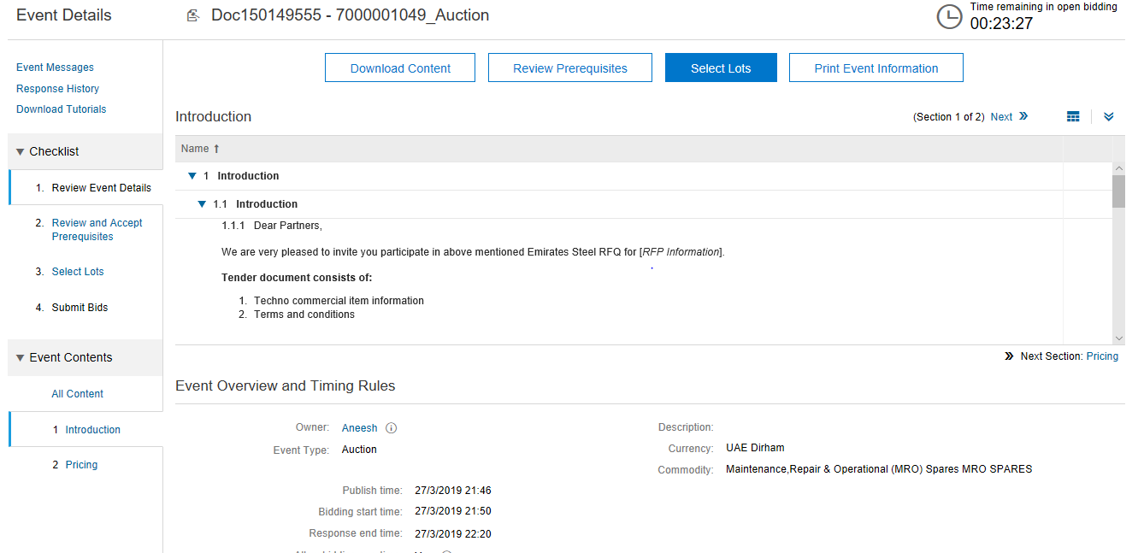
Selecting Lots
1. Click on Select Lots

Slide 13
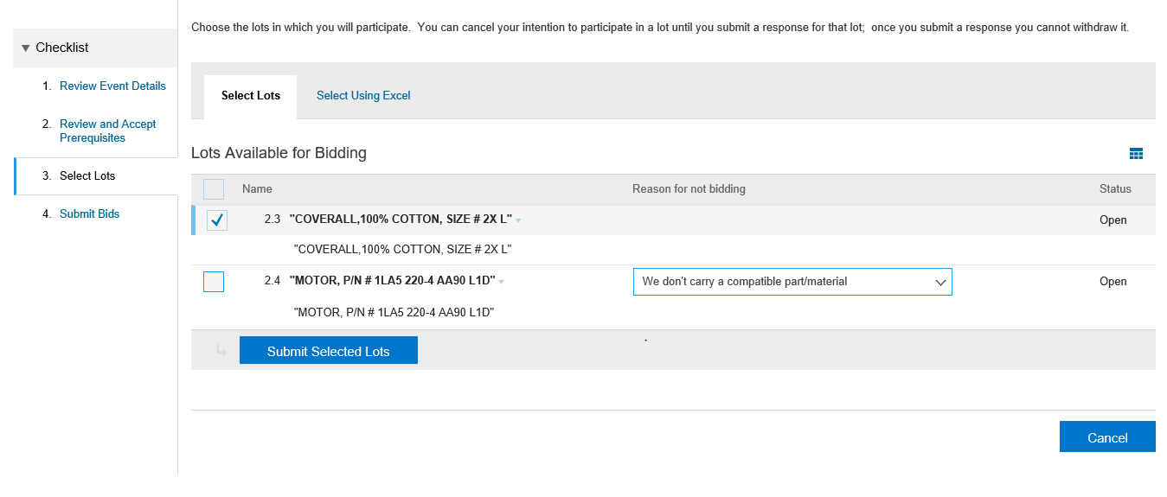
Selecting Lots
1. Select the Lot for which you intend to Bid
Supplier declined to Bid
2. Click Submit Selected Lots

Slide 14
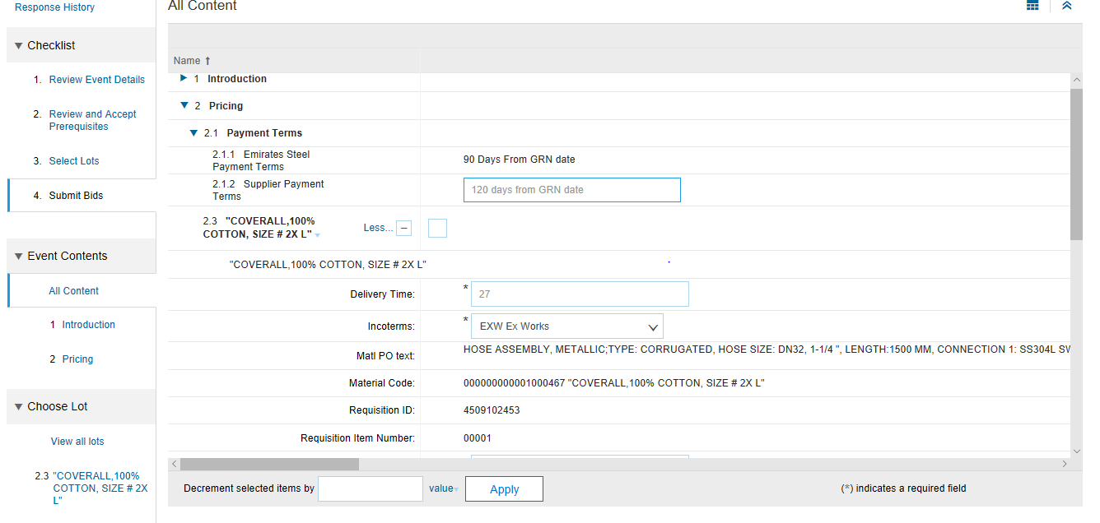
Submitting Response
1. Input all required values

Slide 15
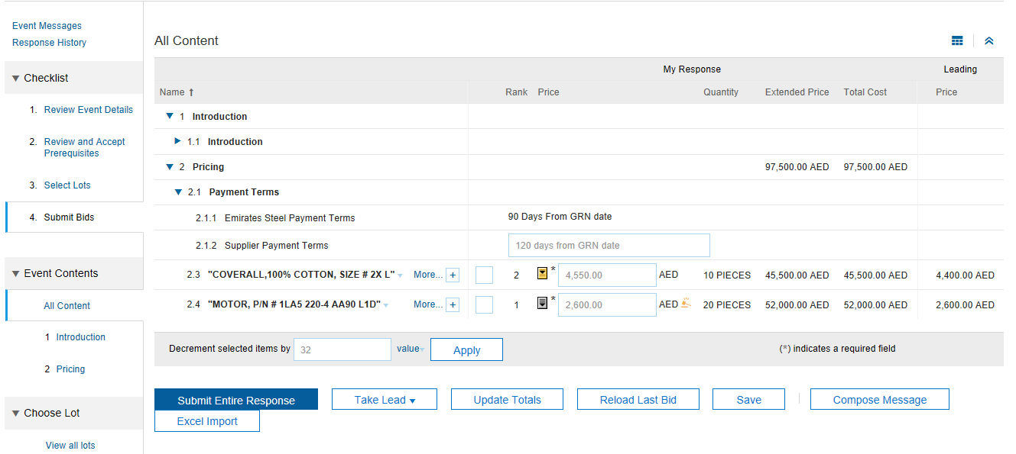
Submitting Response
1. Suppliers submitting Bid Amount
2. Click on Submit Entire Response

Slide 16
Thank You

