Slide 1
Login To Portal Using Buyer ID

Slide 2
Enter your User ID
Enter Your Password
Click on for Login

Slide 3
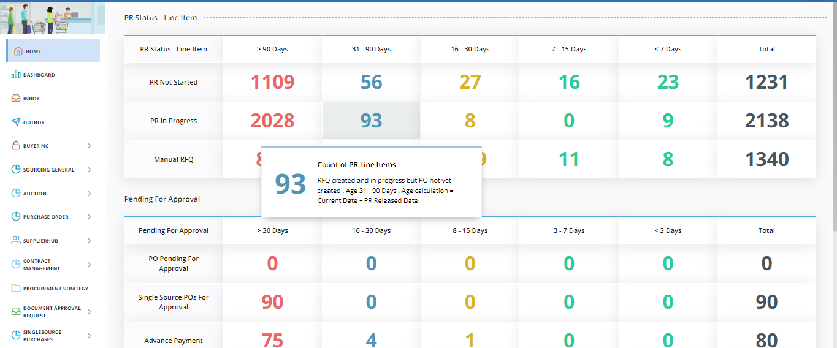
Click on Contract Management Menu

Slide 4
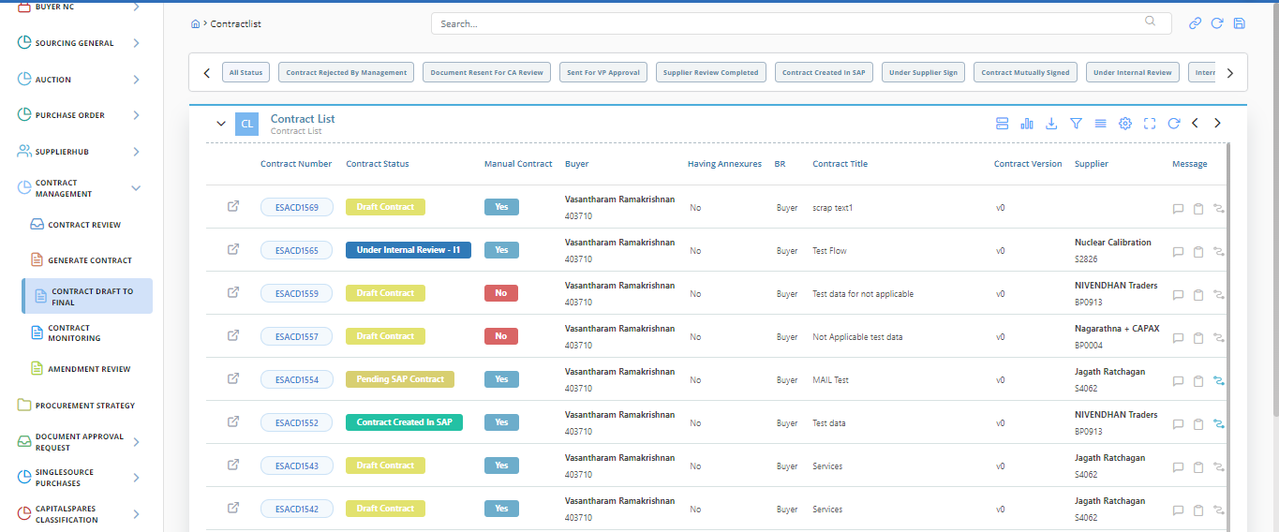
Click on Contract Draft To Final
Here we can find the Contract Number

Slide 5
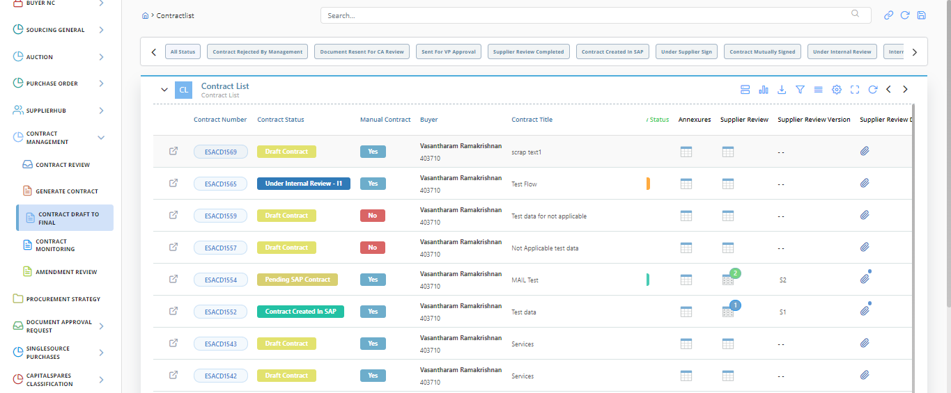
Scroll Right and Find Supplier Review Menu

Slide 6
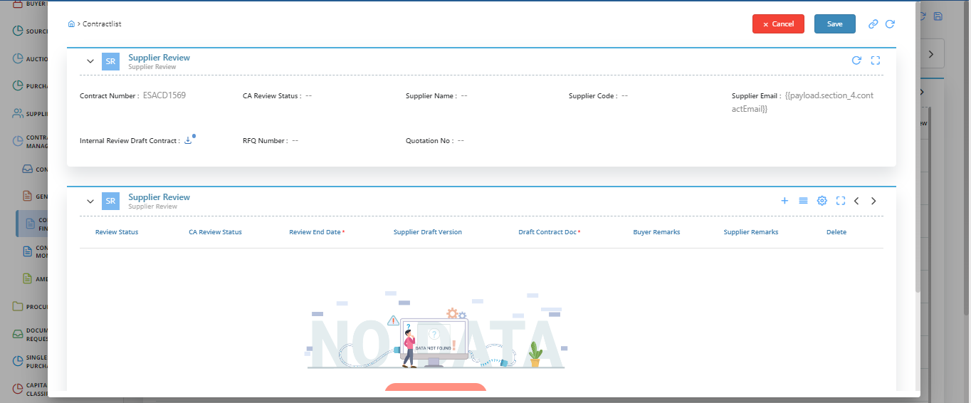
Click + button for New Entries

Slide 7
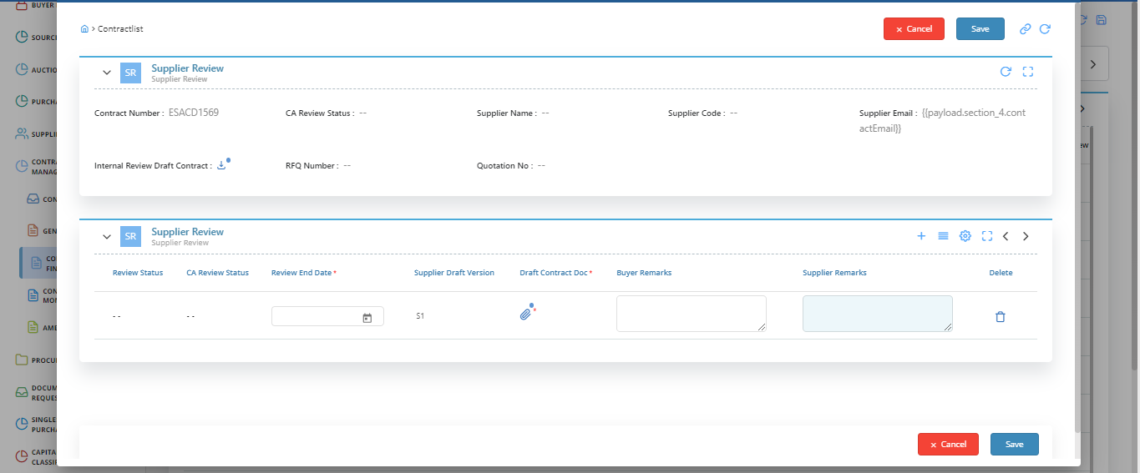
Give Review End Date
Click on Save Button

Slide 8
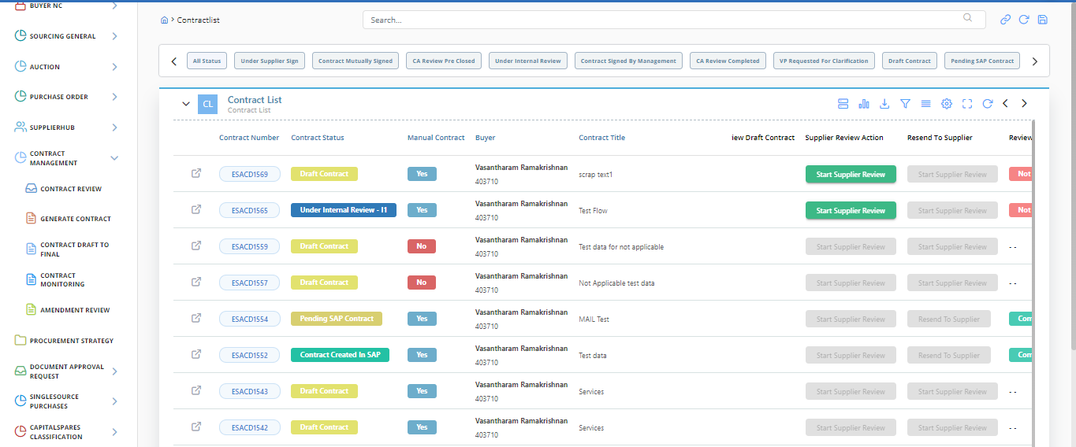
Click on Start Supplier Review

Slide 9
Login To Portal Using Vendor ID

Slide 10
Enter your User ID
Enter Your Password
Click on for Login

Slide 11
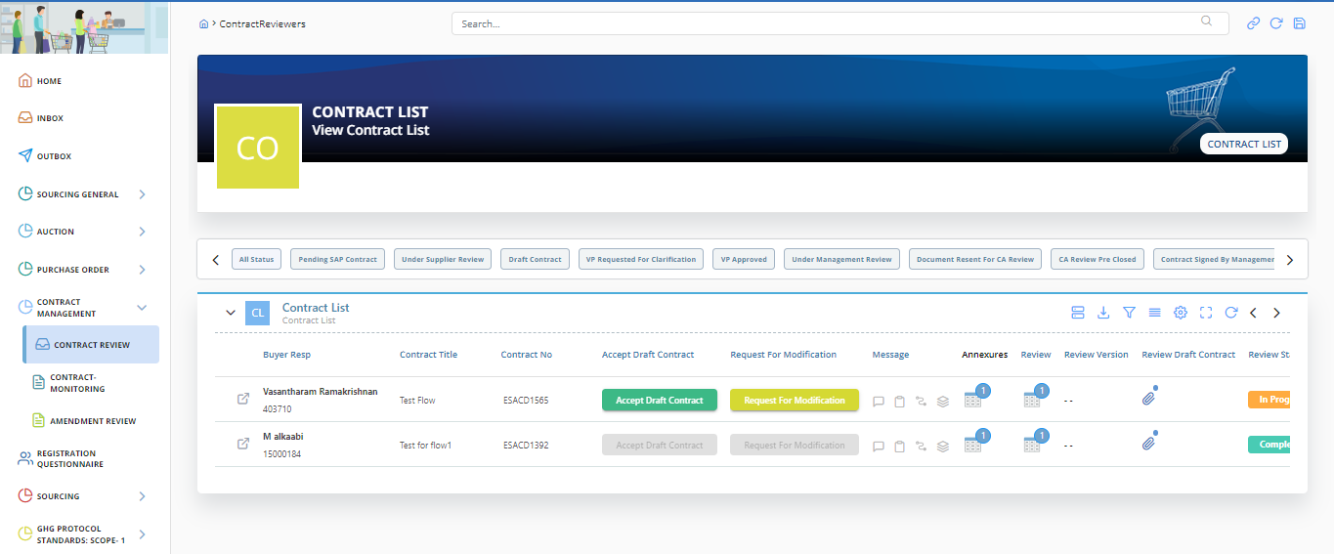
Click on Contract Review
Accept the Draft Contract

Slide 12
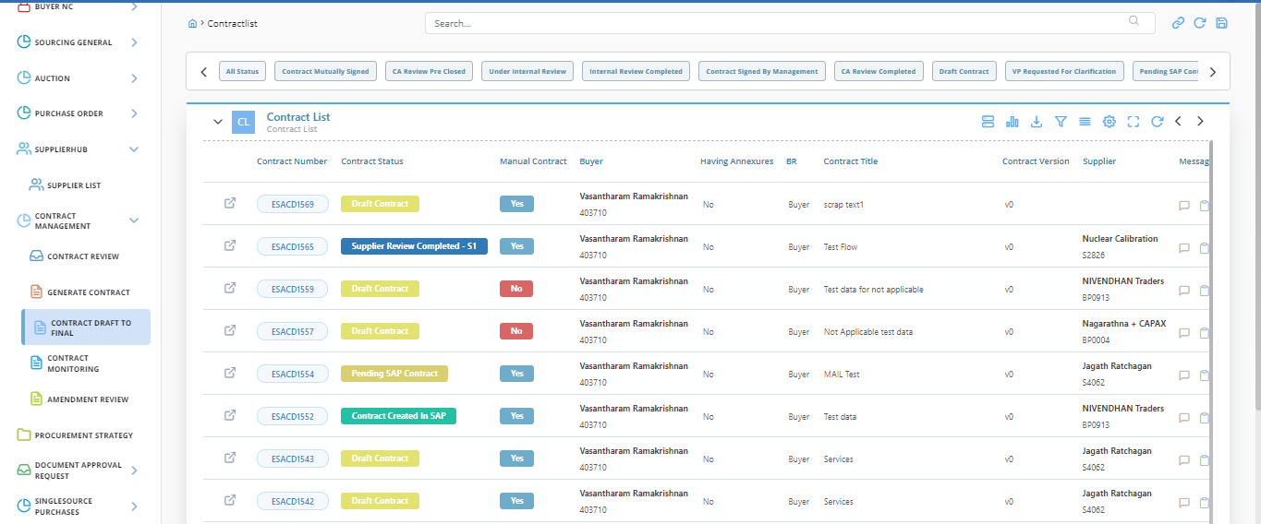
After Supplier Accepted the Draft means the status changes to Supplier Review Completed

Slide 13
IF SUPPLIER REQUESTED FOR CLARIFICATION

Slide 14
Click on Contract Review
Request For Modification

Slide 15
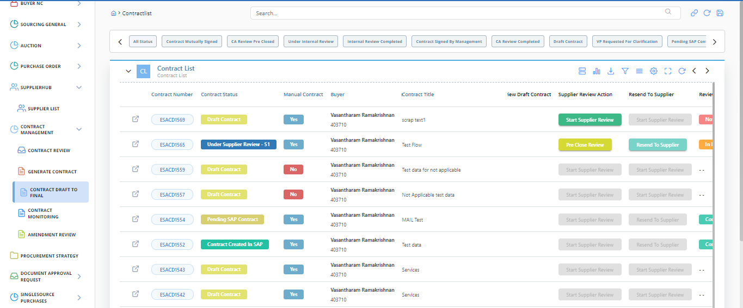
While Supplier Request for Modification Means the Resend to Supplier Button Enable to Buyer

Slide 16
Login To Portal Using Vendor ID

Slide 17
Enter your User ID
Enter Your Password
Click on for Login

Slide 18
Click on Contract Review
Accept the Draft Contract

Slide 19
After Supplier Accepted the Draft means the status changes to Supplier Review Completed

Slide 20
THANK YOU

